Slide 1
Amazon Product Sales analysis
Presented by
Sakshi Sunil Tekale

Slide 2
Information about project and dataset
1. Project Overview
The goal of this project is to analyze Amazon product sales based on brand performance, discount trends, and pricing strategies. By leveraging data analysis techniques, we can derive insights into:
Which brands offer the highest discounts
The price range of different product categories
The relationship between MRP, selling price, and discount percentage
How different product sizes affect pricing.

Slide 3
2.Dataset overview
Column Name | Description
S.No | Serial number, unique identifier for each product
BrandName | The name of the product’s brand (e.g., aarke, Adidas, allen solly, catwalk)
Product Name | The specific name/model of the product (e.g., casio118 - watches-women,Adidas Sneakers)
Brand Desc | A brief description of the brand (e.g.,"printed mandarin cotton blend womens dress - yellow")
Product Size | Size details of the product (e.g.,Large,Medium,Small,X-Small,X-Large,XX_Large,XXX-Large)
MRP | Maximum Retail Price (Original price before discounts)
SellPrice | The price at which the product is sold on Amazon
Discount | Discount amount or percentage on the product
Category | The product category (e.g., Westernwear, Indianwear, Footwear, Jewellery, Watches, Fragrance).

Slide 4
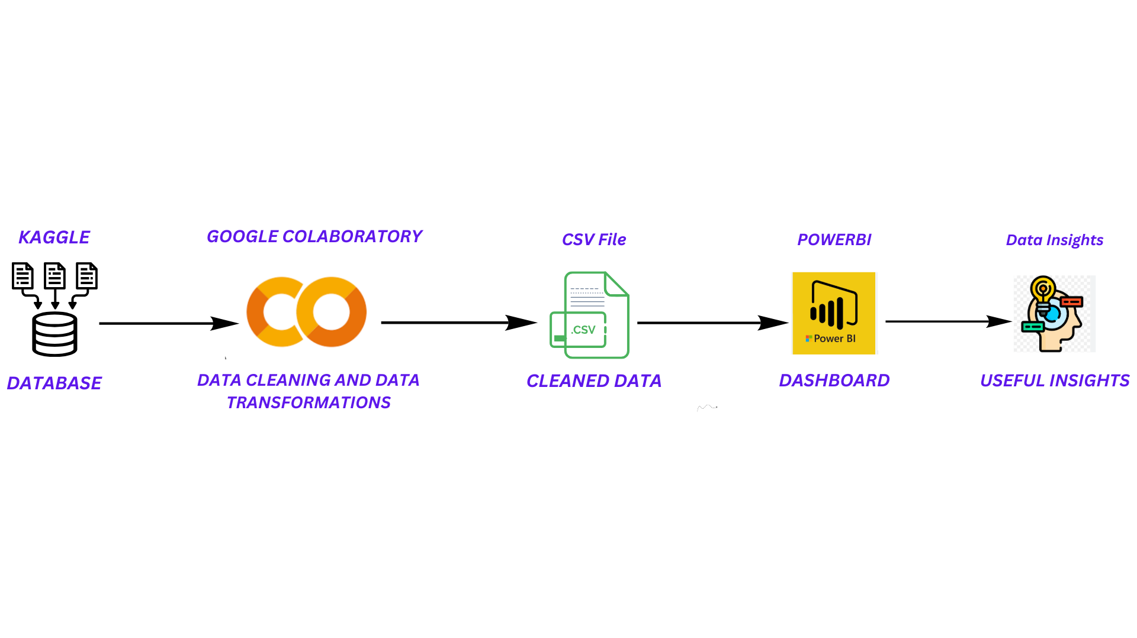
Architecture diagram of project

Slide 5
Data cleaning and data transformation
1) Checked the shape of data, it has 4566 rows and 11 coloumns.
2) Extracted the summary of data using info function and checked null count and data type of each coloumn.
3) Checked missing values of each coloumn.
4) After checking missing values, MRP coloumn has 13 missing values and then dropped that rows which has missing values.
5) Checked for duplicate values and dropped duplicate values.
6) Checked data types of each coloumn it shows that MRP and Discount coloumn is in object data type, converted it into integer.
7) Then discount coloumn has % and off , dropped that also.
8) Dropped coloumn product id and currency which are unnecessary coloumns.

Slide 6
9) Extracted value count of each coloumn.
10) Dropped ‘women’ name from category coloumn.
11) Changed size names with its first letter
12) Changed Product Names to lowercase and replaces extra characters

Slide 7
Data insights
1) Average MRP is 1817.69
2) Minimum MRP is 0.0
3) Maximum MRP is 28495
4) Average Selling price is 2005
5) Minimum Selling price is 89
6) Maximum Selling price is 25995
7) Top 10 brands by average MRP are :
1) Coach 6) Abercrombie and Fitch
2) Casio 7) Carolina Herreca
3) Man Made 8) Boucheron
4) Anne Klein 9) Clarks
5) Aigner 10) Alcis

Slide 8
8) Top 5 Most Common Product Sizes
1) Size:Large,Medium,Small,X-Large,X-Small,XX-Large 315
2) Size:Large,Medium,Small,X-Large 172
3) Size:Large,Medium,Small,X-Large,X-Small 164
4) Size:8,10,12,14,16,18 136
5) Size:8 101
9) Most Expensive brand is COACH.
Least Expensive Brand is ARIANA.
11) Most Expensive Product is COACH-18-WATCHES-WOMEN which has MRP of 28495 and selling price is 17097 and has discount of 40%.
12) Least Expensive Product is AARKE29-INDIANWEAR-WOMEN which has selling price of 4700 and discount is 10%.
13) Most Expensive Category is WATCHES.
14) Least Expensive Category is JEWELLERY.
15) The Product Name with the most discount is DRW58-WESTERN WEAR-WOMEN.
16) The Product Name with the least discount is CLARA1-JEWELLERY-WOMEN.

Slide 9
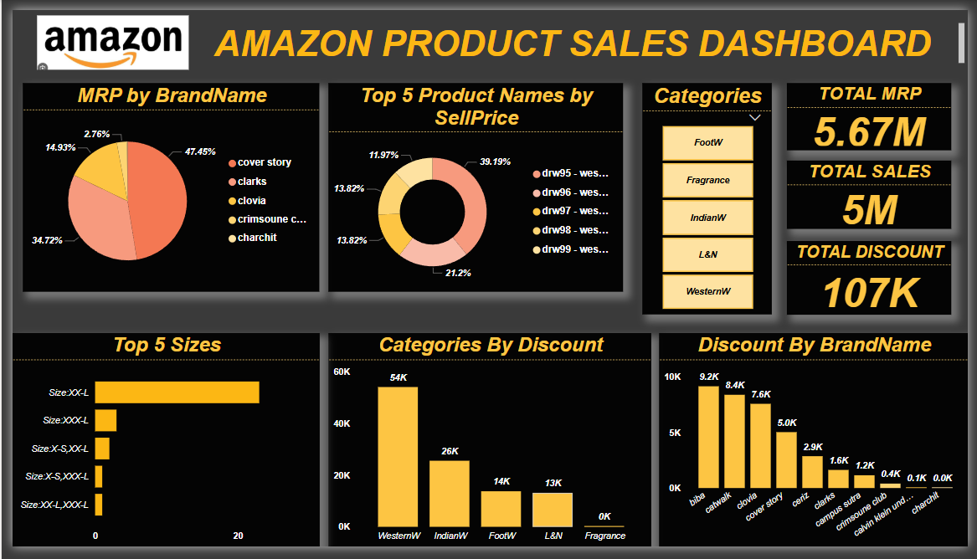
Amazon product sales dashboard

Slide 10
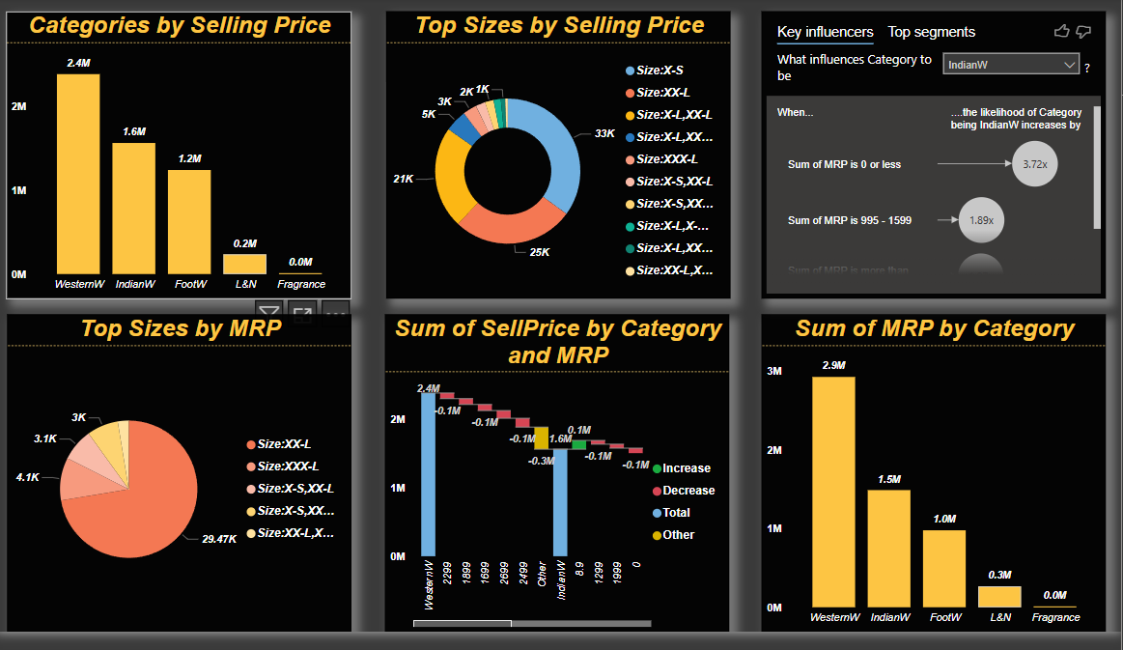

Slide 11
Dashboard overview
1) Sum of Discount is 107K
2) Sum of Selling Price is 5M
3) Sum of MRP is 5.67M
4) Top 5 Sizes are XX-L, XXX-L, X-S & XX-L, X-S & XXX-L, XX-L & XXX-L.
5) Top 5 Brands by MRP are Cover Story, Clarks, Clovia, Crimsoune, Charchit.
Cover Story has highest MRP’s
6) Western wear category has highest discount
7) Brands like Biba, Catwalk, Clovia, Cover story, Ceriz has highest discount.

Slide 12
Thank you….

